Slide 1
Instructions for the Game

Slide 2
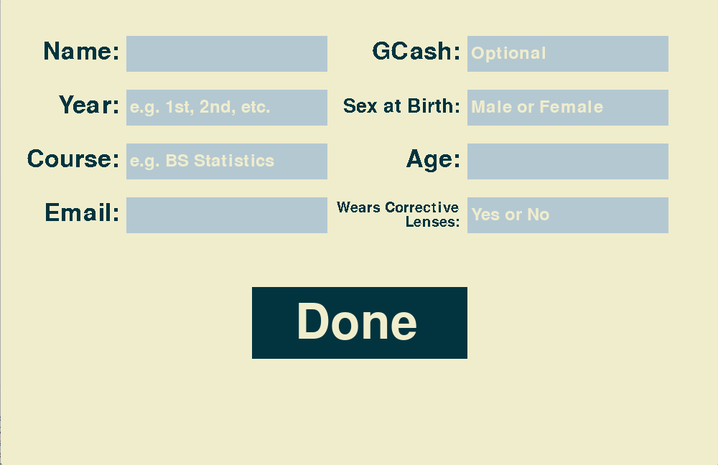
1 of 7
Fill in all the required information and Click ‘Done’

Slide 3
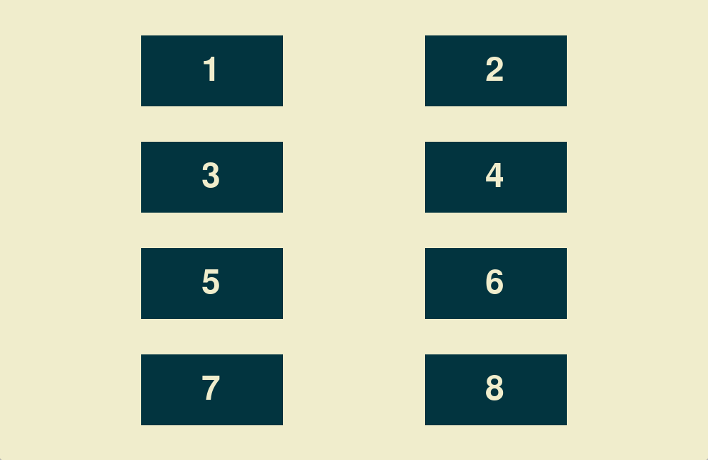
2 of 7
Click the rectangle with the number assigned to you

Slide 4
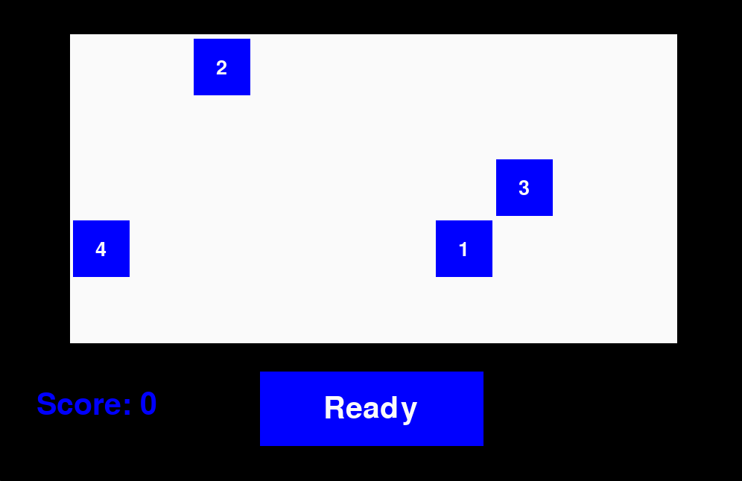
3 of 7
Remember the order of the numbers inside the shapes then click ‘Ready’

Slide 5
4 of 7
We will be measuring how long it takes you to memorize each round. A prize will be given to the player with the best accuracy and memorization speed

Slide 6
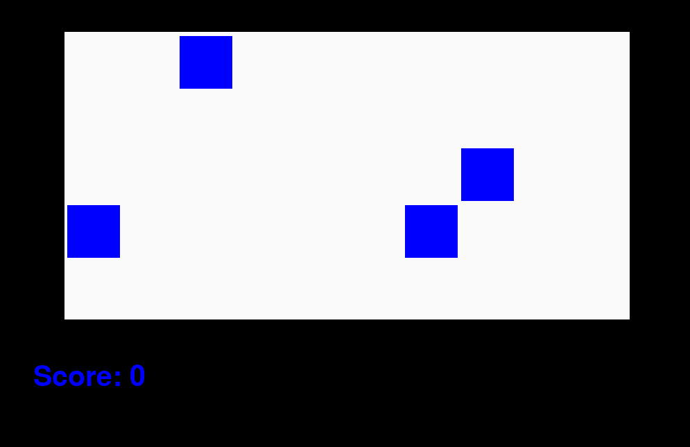
5 of 7
Click the shapes in the correct sequence, beginning with 1

Slide 7
6 of 7
We are not measuring how long it takes you to click the shapes so you can take your time

Slide 8
7 of 7
The game ends after 15 shapes or 12 rounds
Good luck and have fun!

